Slide 1
Wrapping up and What Is Next?

Slide 2
Prototype v2.0

Slide 3
Display a map
Select a shop
Marker shows location
User can search Detect user location Get directions Scalable
Store Locator Requirements

Slide 4


Slide 5












RED
REFACTOR
GREEN

Slide 6
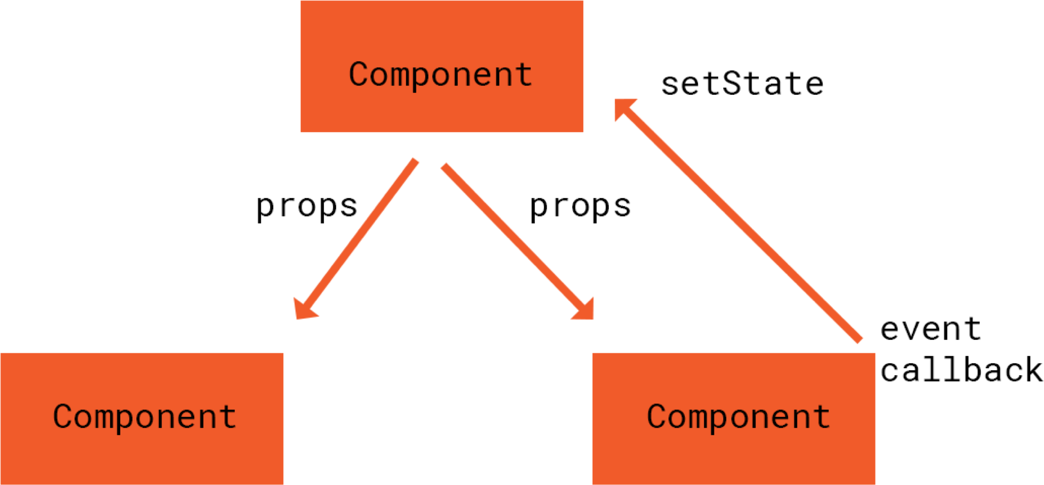

Slide 7
Demo
Snapshot Testing

Slide 8




What Is It Good For?
Complement conventional tests
Test less clearly defined aspects
Not for critical logic
Not for understanding developer expectations

Slide 9
Demo
Code Coverage

